Slide 1
Cordova Development
Nick Tann
Brendan Acosta
Zachary Stachowiak

Slide 2
Scope

Slide 3
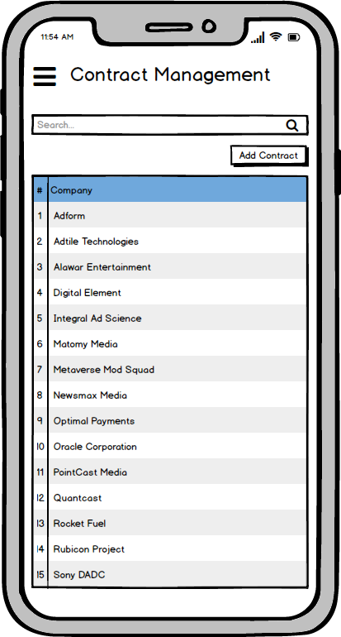
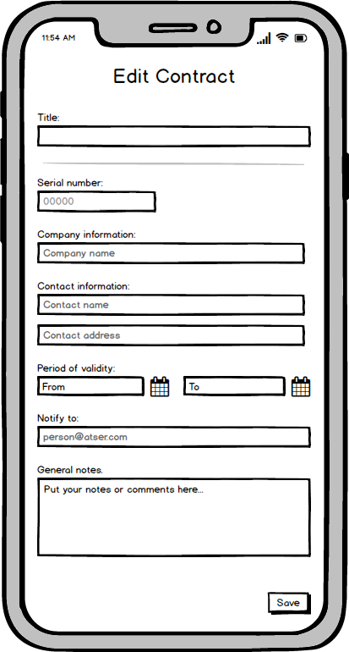
Application Task
Using Cordova build an app that allows the user to access, edit, delete and add contracts to a database

Slide 4
Setup
Apache Cordova - mobile application development framework. Targets multiple platforms with one code base
Node.js - Cordova command line runs Node.js. A JavaScript runtime environment that executes JavaScript outside a browser.
JDK - development environment for Java
Gradle - an open-source build automation tool
Android Studio - the IDE for Android OS
Xcode - the IDE for IOS
Visual Studio 2017 - the IDE from Microsoft. We are able to edit and execute Cordova Code from here
.Net - provides language interoperability across programming languages.
Notes:
What we needed to startup and run Cordova

Slide 5
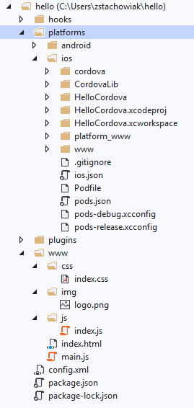
Usage
Cordova can be built and tested in the Console or in Visual Studios 2017
ONLY available in VS 2017! VS 2019 does not support Cordova
Cordova Command-Line Interface
Use keyword ‘create’ to create a new project, upon which a files shown on right will be created
Use keyword ‘platform add <platform>’ to include other platforms into project
Index.html is the ‘main’ page and uses support from css, img and js files
Override functions for specific platforms inside the platforms folder
Visual Studios includes a package that can build Cordova apps
Uses similar file layout but includes a platformOverrides.js and automatically drops them into the correct platform folder
Both include emulator options to test the code
Notes:
How to create project, edit files, build and test

Slide 6
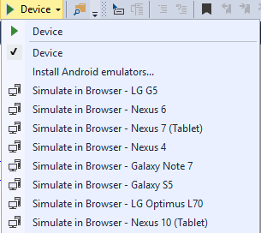
Android Deployment
For debugging can be deployed onto a device using Visual Studio or Android Studio
Straight forward compared to iOS
Requires only a few settings changes on the device
Allow for file transfer through USB and enable “unknown developer” apps if no provisioning was used
Simple plug and play in both studios
For Android store requires slightly more
Requires a free provisioning account that need to be setup only once
The “signature” of the developer
Google Developer Account is a one time $25 cost which grants access to Play Store
Notes:
The things we did and issues we ran into to deploy to android device

Slide 7

iOS Deployment
For Debugging must be exported to a Mac in order to use Xcode
Cordova project can be manually moved or use a tool such as “remotebuild” in order to connect to the Mac and build in PC
We were unable to get remotebuild to work due to compatibility issues
Unlike Android debugging requires a provisioning profile in order to export onto a device
Can then deploy on device either through Xcode or VS 2017 with remotebuild
For Apple Store
Requires a $100 per year Apple Developer Account
Provisioning profile required
Also requires a production certificate and registering the app with your Development Account
RIP Brendan’s Mac
2014-2019
XCode is crap
Notes:
The things we did and issues we ran into to deploy to ios device

Slide 8
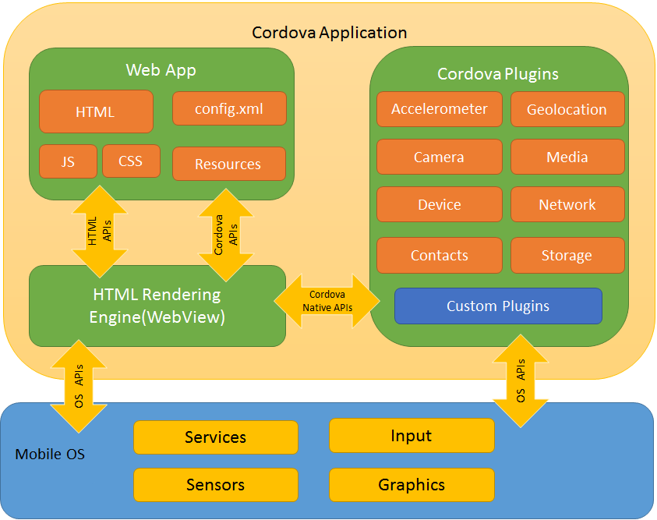
Cordova Plugins
Fairly straight-forward
Download from online using npm install
Place into project using “cordova plugin add <plug-in>”
Automatically places needed directories into config.xml file
Documentation provided via cordova website
Used a haptic response plug-in as a proof of concept

Slide 9
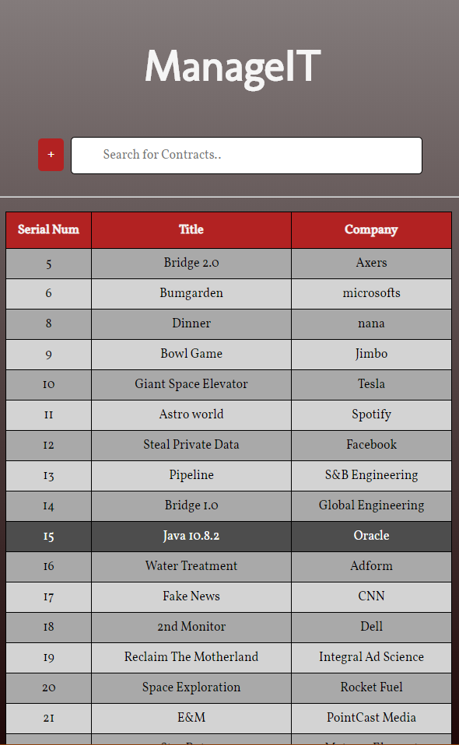
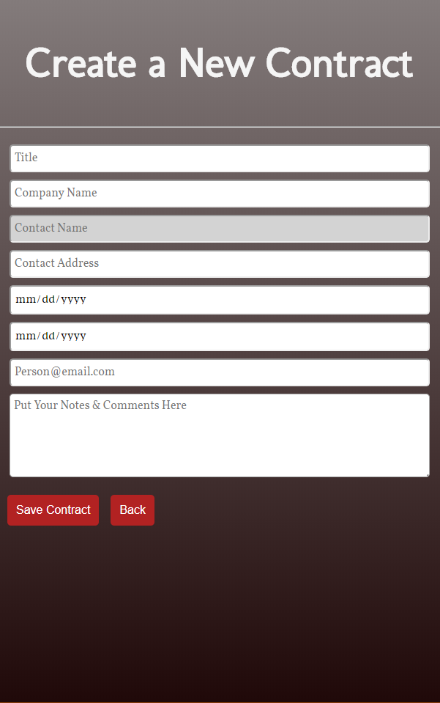
Results
The current version of our app allows access to edit delete and add contracts to a local database.
Improvements can be made on the graphic design.
Wireless access to a server database has yet to be implemented

Slide 10
Pros and Cons
Pros:
CSS makes visual customization very easy and intuitive
Cordova can target multiple platforms with one base code
Plugins provide access to device and platform functionality that is ordinarily unavailable to web-based apps
Cordova can build the app for different platforms within cordova, no need to use different IDE’s
Prior knowledge of web development makes using cordova smoother (jQuery,CSS,SQL)
Cons:
Cordova is not currently compatible with VS 2019
Using multiple html pages adds much complexity in app design (recommended to use one page if possible)
Must use macOS to deploy on iOS devices (this is not exclusive to Cordova however)
Running apps in webview could hinder performance in some cases (as opposed to native apps)
Cordova does not handle cross-browser compatibility well
Notes:
What was good and waht sucked ass

Slide 11
Conclusion
Problem - We were tasked to develop an app that could access and store contract information using Cordova
Result- A functioning app was created successfully using html, CSS, and Javascript
Problem - The app needs to be made for iOS and Android (cross-compatible)
Result - Using the android SDK and Xcode, we were able to deploy the app to both platforms successfully

